Slide 1
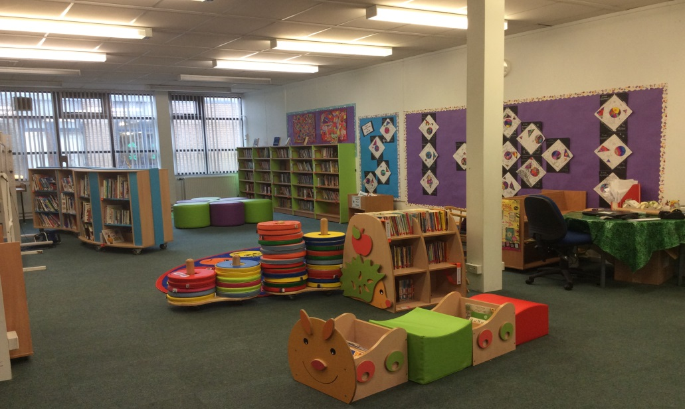
Cults Primary /Nursery School
Parent Council Meeting
Monday 14th March 2016

Slide 2
Key National Issues
Education Bill
Scottish Attainment Challenge
National Improvement Framework
Particular focus on Early Years – Literacy, Numeracy and H&WB
Notes:
A Bill for an Act of the Scottish Parliament to impose duties in relation to reducing pupils’ inequalities of outcome; to modify the Education (Additional Support for Learning) (Scotland) Act 2004 and section 70 of the Education (Scotland) Act 1980; to make provision about Gaelic medium education, about the provision of school meals, for appointing Chief Education Officers and in relation to registration of independent schools and teachers in grant-aided schools; to extend the duty to provide early learning and childcare to certain children; and for connected purposes - See more at: http://www.scottish.parliament.uk/parliamentarybusiness/Bills/87330.aspx#sthash.8shM2z5b.dpuf
The Scottish Attainment Challenge was launched in Feb 2015, to focus & accelerate targeted improvement activity in literacy, numeracy and health & wellbeing. It also supports and complements the broader range of initiatives and programmes to ensure that all of Scotland’s children and young people reach their full potential
Gayle Gorman has been working closely with 7 other authorities in North Scotland regarding the challenge, to combine our efforts to ensure we provide support for all.
The National Improvement Framework was launched on 6 January and provides standardised assessment tools.
The framework will allow us to better support individual children’s progress to identify improvement.
The information which is gathered will help us to set precise milestones for closing the gap in attainment

Slide 3
Aberdeen City Priorities
Early years phonics
Reading P6-S2
Mental Maths P3-P6
ICT 360 self review
Languages 1 + 2
Developing Young Workforce
Rights Respecting Schools

Slide 4
Cults Primary Priorities
Curriculum
ICT
Outdoor Learning/Playground
Target Setting/PLP/Learning Logs
Higher Order Thinking Skills
Peer Mentoring
Partnership with Parents
Notes:
Changes to delivery of curric – bundling – accountability but retaining flexibility/personalisation
ICT – developing higher order skills – programming
Continue to develop appropriate use of the outdoors – very good at ES – tails off up the school
PLP etc – needs to be refined – further involve parents
HOT – reflective reading, Blooms Taxonomy

Slide 5
Other Pertinent Issues
Increasing Roll
Ongoing Staffing Issues
Early Years Staffing Changes
Inclusion
Fiscal Challenges for the Council

Slide 6
Now the good news!
P7 participation in annual Rotary Quiz – came 2nd
P7 transition events underway – visits to CA planned, Mr Angus visited P7 last week
Very successful P6 and P6/7 performances with Scottish Opera
All P4-7 classes learned Scots Verse, finalists from each year group and overall winners
All P4 pupils attending weekly swimming lessons at Cults Academy this term
Successful Problem Solving Day for all P1-7 pupils and new resources purchased (funding from PTA)

Slide 7
And more……….
Currently supporting teaching students in P1S and P3S
February INSETs focus on breadth and depth of curricular areas taught within IDL and progression within numeracy and mental maths
Pupil Council consulted re re-zoning and new school menu.
Voice Box competition school winner invited to Westminster as part of runner up prize.
Current in-school competition to design Summer Fair logo with Mud No More theme

Slide 8
And finally…..
Live links with sister school in Atlanta, Georgia (P4C, P4B, P3S, P6/7) – PC involved in welcoming Mr Young in June
New report format – staff trained and writing currently – to be issued May
Health Committee Newsletter/Partnership with Kippie Lodge
Numeracy Curricular Evening
Wear a Hat Day (Brain Tumour research) – Open Day – 24th March

Slide 9
